Slide 1
Analysis of Genetic Variant Classifications
Michael Martinez

Slide 2
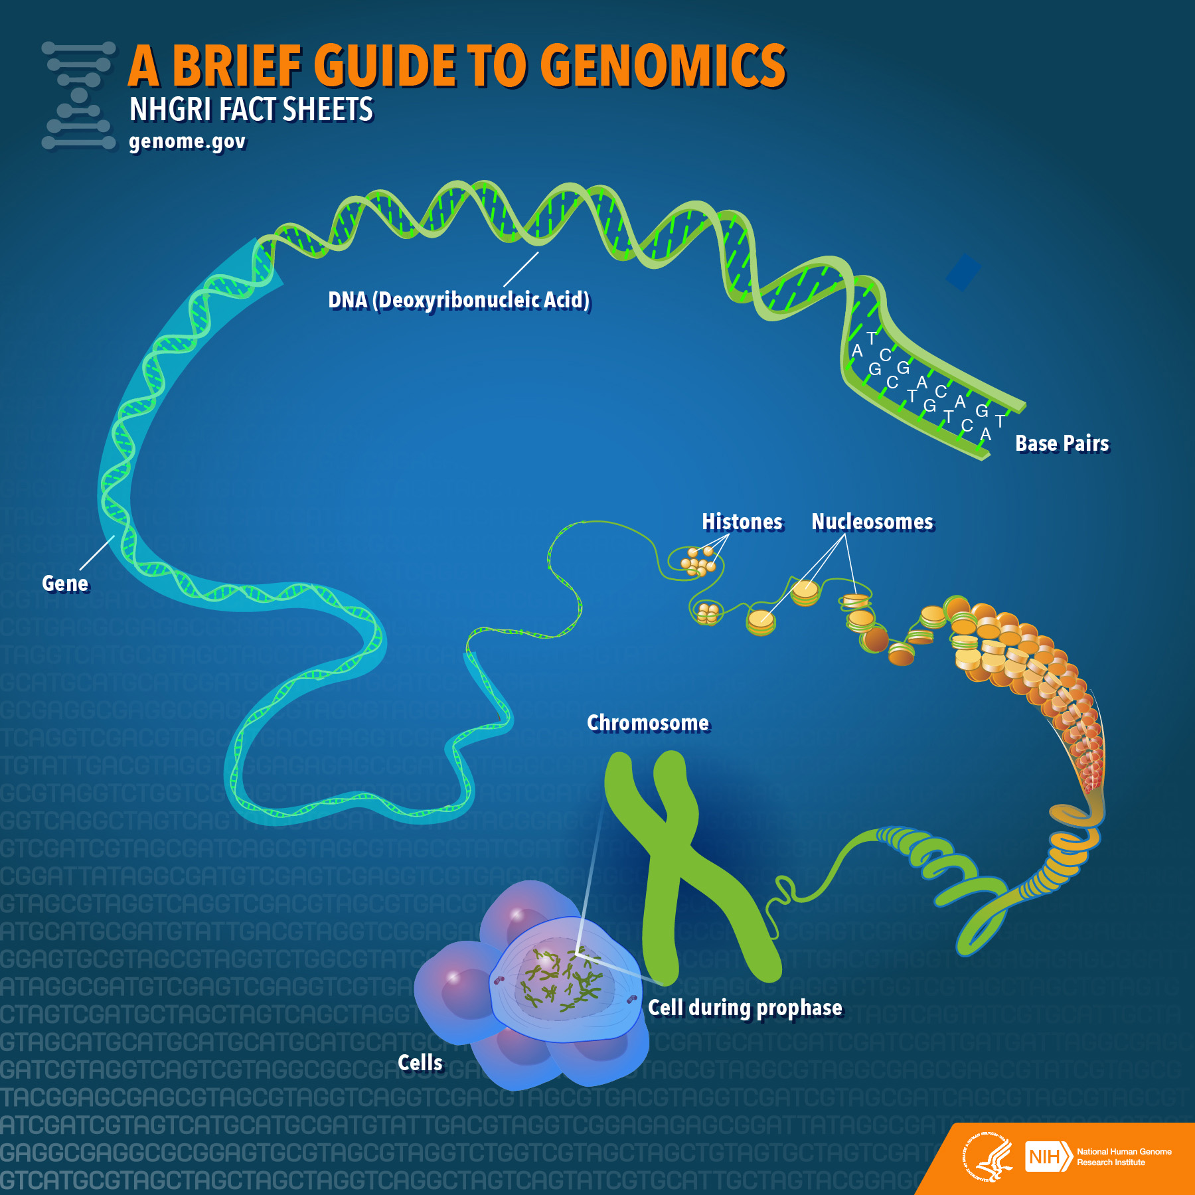
Genetic Variants and Genomes
Genetic variations, or variants, are the differences that make each person’s genome unique.
A genome is the entire set of genetic material for an organism.
The average person’s genome has millions of variants.
Some variants contribute to the differences between humans, such as different eye colors and blood types
Other variants have been linked with diseases
Most variants have currently have unknown effects.

Slide 3
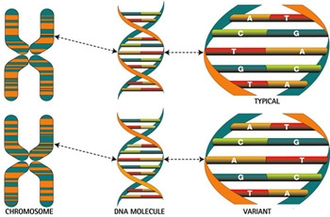
Genetic Variant Classification
Pathogenic - a sequence variant that is previously reported and is a recognized cause of the disorder.
Likely Pathogenic – a sequence variant that is previously unreported and is of the type which is expected to cause the disorder.
VUS (Variant of Unknown Significance) – a sequence variant that is previously unreported and is of the type which may or may not be causative of the disorder.
Likely Benign – a sequence variant that is previously unreported and is probably not causative of disease.
Benign – a sequence variant is previously reported and is a recognized neutral variant.

Slide 4
Data and Capstone goal
The data I am using has been collected through CLINVAR
ClinVar is a freely accessible, public archive of reports of the relationships among human variations and phenotypes, with supporting evidence. ClinVar thus facilitates access to and communication about the relationships asserted between human variation and observed health status, and the history of that interpretation.
My Capstone project will analyze genetic variant classifications between laboratories and seek to determine patterns in measured data that lead to agreements or disagreements in said classifications.
This data set contains 65188 observations each with 45 variables measured per record and 1 label variable ‘CLASS’- indicating a lab agreement or lab conflict

Slide 5
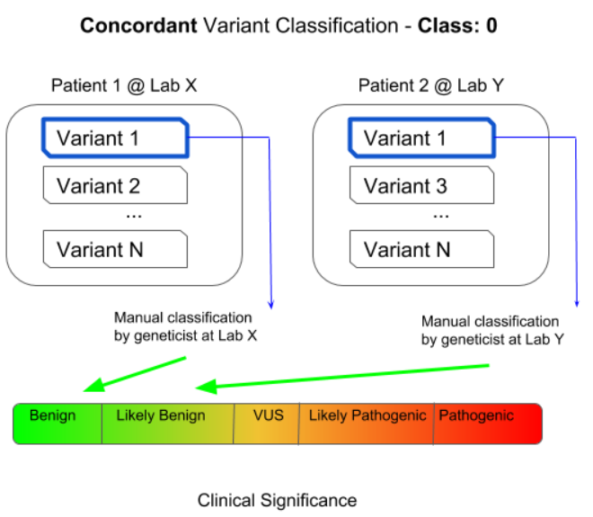
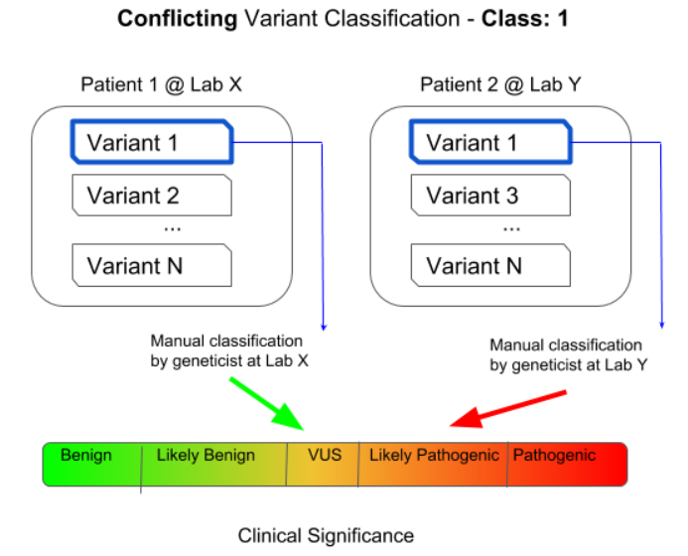
Understanding the Target Variable
The ‘CLASS’ feature variable of the dataset is a binary representation of the outcome of lab agreement or conflict. An agreement is encoded as 0 and a conflict is encoded as 1.

Slide 6
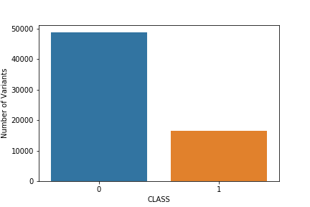
Visual Data Overview (classification breakdown)
The breakdown of the number concordant and conflicting classifications between labs. From this visual, we can see that there are roughly 3 times more concordant classifications than there are conflicting classifications.

Slide 7
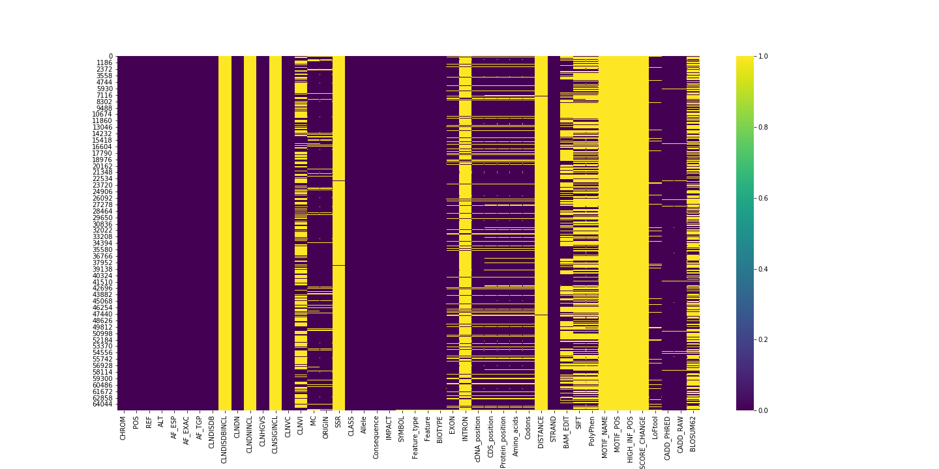
Visual Data Overview (null entries)
This plot provides a visual representation of the number of null entries in all feature variables- where yellow marks a null entry in a given feature variable. This number is noticeably inconsistent between variables (meaning some features have more or less null entries than others). Notice how some feature variables have a solid yellow bar-indicating that it contains mostly null entries.

Slide 8
Data Cleaning and Processing
The data cleaning and processing phase of this analysis will involve 2 steps
Filter out of the dataframe all features with less than 50000 non-null entries
Drop features with > (10% of number of observations) unique values
The ultimate goal of this analysis is to discover patterns and relationships between feature variables and laboratory classifications. I will therefore drop those features which contain several null values or contain several unique values (which would inhibit pattern findings).
Result of data cleaning and processing:
44572 observations and 21 feature variables

Slide 9
Data Visualization (further processing)
In visually inspecting the feature variables as they relate to the target variable to see if I can determine outstanding relationships. To do this I will first need to cross-tabulate the data i.e. how many times each value of the features occurs in which classification (0,1). I will take the top *x* results and visualize their cross-tabulation with the classifications by constructing three heatmaps as described below:
A number of occurrences count cross-tabulation that shows how many times a specific value occurred in which classification
A percentage-of-total cross-tabulation, which will show the *percentage* of the *total number* of values each value has in the cross tabulation
A split percentage cross-tabulation, which will show the percentage breakdown of classification between values (i.e. 40% classified as 1 and 60% classified as 0)

Slide 10
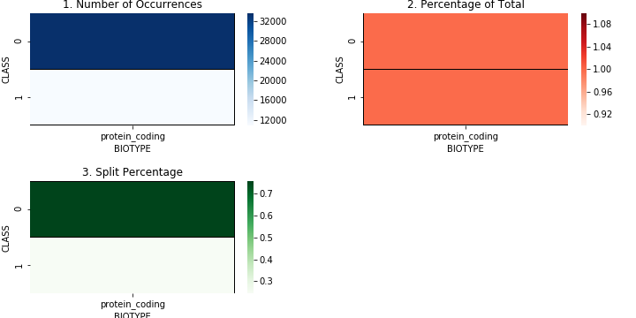
Sample of Bad Trend (one unique value)
The feature variable ‘BIOTYPE’ showed that it only contained one unique value and therefore would not be helpful in a binary classification prediction. A similar observation is seen in the variable ‘Feature_Type’.

Slide 11
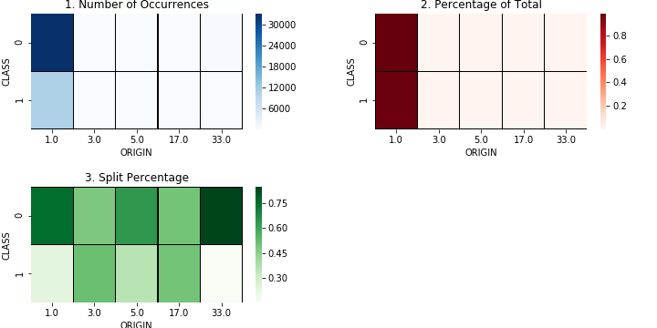
Sample of Bad Trend (too few unique values)
Feature variable ‘ORIGIN’ exhibited a similar problem as the “one unique value” problem. From the heatmaps, we can see that the percentage breakdown is dominated by a single value.

Slide 12
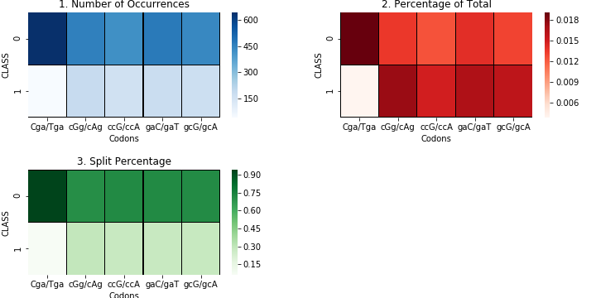
Sample of Bad Trend (too many unique values)
Feature variable ‘Codons’ contained too many unique values. Observing that the most frequently occurring value constitutes 1.8% of the total number of values.

Slide 13
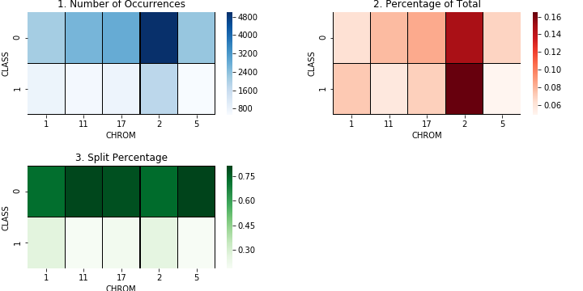
Sample of Good Trend
Feature variable ‘CHROM’ exhibits a positive trend. The percentage breakdown of the top most occurring values shows much higher proportions. Furthermore, the Split Percentage heatmap shows a ratio in some values that is notroughly 3:1, which points towards some correlation.

Slide 14
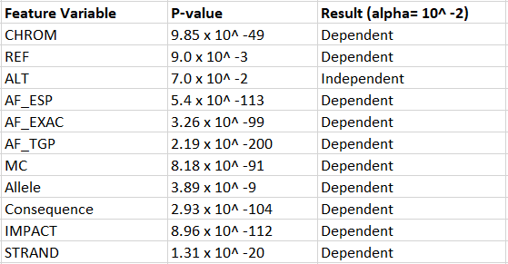
Pearson Chi-squared Test
The Chi-Squared test is a statistical hypothesis test observed frequencies vs expected frequencies under the null hypothesis- the observed frequencies match expected frequencies i.e. the two variables are independent
From chi-squared test, I drop the feature variable ‘ALT’

Slide 15
Feature Engineering
Feature engineering is the process of using domain knowledge of the data to create features that make machine learning algorithms work. Feature engineering is fundamental to the application of machine learning and I will be using 3 methods to preprocess my categorical data.
One hot encoding
Label Encoder
Feature Hashing
The three feature-processed dataframes will all have several ML algorithms applied to them. In this sense, I can observe the most successful feature preprocessing method.

Slide 16

Machine Learning Algorithms
My analysis includes the application of the following machine learning algorithms
Logistic Regression
Decision Tree
Random Forest
Gradient Boosting
Support Vector Machine
Each ML algorithm will be applied to each preprocessed dataframe. Performance will be evaluated using a few metrics such as accuracy, precision, recall, and f1 score.

Slide 17
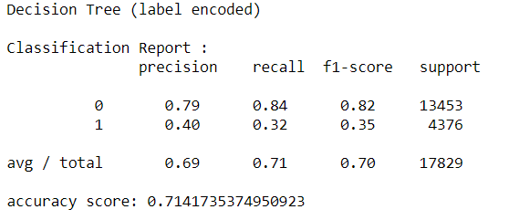
Decision Tree- Label Encoded data
The best performing machine learning model is the Decision Tree when applied to the label encoded data, in terms of the accuracy, precision, recall, and f1 scores in both lab agreements (0) and lab disagreements (1).

Slide 18
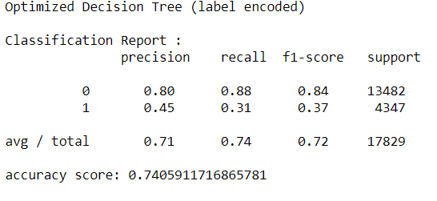
Optimizing the Decision Tree
I optimize the Decision Tree by tuning relevant parameters (‘max_depth’, ‘min_samples_split’, and ‘min_samples_leaf’) by usingthe GridSearchCV method form sklearn.model_selection. The best params are respectively 13, 2, 5.
Overall model performance showed an increase with the implementation of these specified parameters

Slide 19
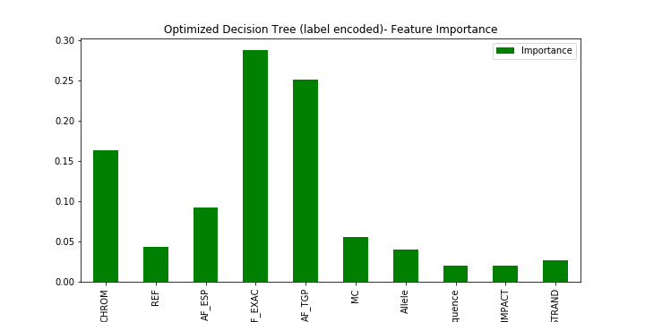
Feature Importance
The suggested feature importance as determined by the Decision Tree is shown to the right. The clear biggest impactors are ‘AF_EXAC’ and ‘AF_TGP’
By the datasets’ definition of feature variables, these are the allele frequencies as defined by two of the three participating labs (ExAC and 1000 Genome Project).

Slide 20
Interpretation
The model determined that the two feature variables ‘AF_EXAC’ and ‘AF_TGP’ consistently had the biggest impact on more than one model’s prediction.
This suggests that the two labs that contributed the most to the target binary variable classification agreement are ExAC and 1000 Genome Project (TGP), directly implying that the third lab’s allele frequency observations did not have as much of an impact on the outcome of the classification agreement/disagreement.
The total laboratory agreement hinged upon these two labs. If ExAC and TGP agreed on a genetic variants’ classification (due in part to their allele frequency measurement), the binary variable would likely take on a value of 0, meaning all three labs agreed on the classification (the third lab GO-ESP agreed on their classification).

